Slide 1
CS5112: Algorithms and Data Structures for Applications
Data representations and real-world efficiency
Ramin Zabih
Sources: Wikipedia; Kevin Wayne, Kleinberg/Tardos

Slide 2
Administrivia
Prelim (midterm) date: Wednesday October 16
In class, closed book
Review session in class on October 7
HW1 is out, due by 10/7
Lectures will be recorded “Real Soon Now”
Minor RDZ error in lecture Wednesday

Slide 3
Lecture Outline
Memory and data representations
Memory allocation
The memory hierarchy
Practical implications for data structure/algorithm design

Slide 4
Computers and arrays
Notion of “constant time” operations relies on a hardware model
Computer memory is a large array
We will call it M, elements M[0], M[1], etc. Integers, for simplicity.
In constant time, a computer can:
Read any element of M
Change any element of M to another element
Perform any simple arithmetic operation
This is more or less what the hardware manual for an x86 describes

Slide 5
Data structures in memory
Today we will focus on implementing various data structures using the array M
We have a contract (API) we wish to fulfill
Example: stack contract
If we push X onto S and then pop S, we get back X, and S is as before
We want to fulfill this contract using the memory array M
We’ll look at related data structures also

Slide 6
Linked lists
You can add items to it, and you can process the items you added
Unlike a stack, don’t need to pop it in order to get at all the items
Adding items takes constant time
Getting each item takes linear time
Example: searching the list for an element
You can also delete an element
This is always the hard part of any data structure, and source of most bugs
If you don’t believe me, look up delete on red-black trees

Slide 7
Linked lists
8
4
1
3

Slide 8
Linked lists as memory arrays
We’ll implement linked lists using M
This is very close to what the hardware does
A linked list contains “cells”
A value, and where the next cell is
We will represent cells by a pair of adjacent array entries
1
2
3
4
5
6
7
8
9

Slide 9
A few details
I will draw odd numbered entries in blue and even ones in red
Odd entries are values
Number interpreted as list elements
Even ones are “cells”
Number interpreted as index of the next cell
AKA location, address, or pointer
The first cell is M(1) and M(2), for now
The last cell has 0, i.e. pointer to M(0)
Also called a “null pointer”

Slide 10
Example
8
4
1
3
1
2
3
4
5
6
7
8
9
8
5
1
7
4
3
3
0
X

Slide 11
Access every item in a list
Start at the first cell, M(1) and M(2)
Access the first value, M(1)
The next cell is at location v=M(2)
If v = 0, we are done
Otherwise, access the next value, M(v)
The next cell is at location v’ = M(v+1)
Keep on going until the next cell is at location k, such that M(k+1) = 0

Slide 12
Adding a header
We can represent the linked list just by the initial cell, but this is problematic
Think about deleting the last cell!
More subtly, it’s also a problem for insertion
Instead, we will have a few entries in M that are not cells, but instead hold some information about the list
Specifically, a pointer to the first element, we use M[1]
Having a counter is also useful at times, we use M[2]

Slide 13
Insert and delete
To insert an element, create a new cell and splice it into the list
Various places it could go
Need to update header info, and the cell (if any) before the new one
To delete an element we simply need to update the header and to change some pointers
Basically, need to “skip over” deleted element

Slide 14
Linked list with header
1
2
3
4
5
6
7
8
9
5
2
2
0
1
3
X
X
X
Initial list:
Insert (end):
Insert (start):
Delete (end):
Delete (start):
1
2
3
4
5
6
7
8
9
5
3
2
7
1
3
E
0
0
1
2
3
4
5
6
7
8
9
7
3
2
0
1
3
S
5
0
1
2
3
4
5
6
7
8
9
5
1
2
0
1
0
X
X
X
1
2
3
4
5
6
7
8
9
3
1
2
0
1
3
X
X
X

Slide 15
Linked lists and deques
Linked lists support insertion/deletion at beginning or end
What is the complexity of these 4 operations?
Is this a good way to implement queues?
How do we modify linked lists so that we can delete from the end in constant time?
We clearly need a pointer to the last element in the header
But this is not enough!

Slide 16
Doubly linked lists
8
4
1
3
8
4
1
3

Slide 17
A doubly-linked list in memory
M[1] points to start
M[2] points to end
M[3] is number of cells
Cells have 3 elements
Before, value, after
Before & after are pointers
Can be null
8
4
1
2
3
4
5
6
7
8
9
4
7
2
0
8
7
4
4
0

Slide 18
Notes on doubly-linked lists
Inserting and deleting is fast, but very easy to get wrong
Try it on all cases, especially trivial ones
Look for invariants: statements that must be true of any valid list
Debug your code by checking invariants
In C/C++, this is done via assert
Most languages have a facility like this built in
But if not, you can just write your own!

Slide 19
Memory allocation
We’ve assumed the hardware supplied us with a huge array M
When we need more storage, we just grab locations at the end
Keep track of next free memory location
What can go wrong?
Consider repeatedly adding, deleting an item
Notice that when we delete items from a linked list we simply changed pointers so that the items were inaccessible
But, they still waste space!

Slide 20


Storage reclamation
Need to figure out certain locations can be re-used (“garbage”)
If too conservative, programs will run slower and slower
“memory leak”
If it’s too aggressive, your program will crash
BSOD or Sad Mac
Suppose your linked list was corrupted
Digression: Why do computers crash when we read/write an arbitrary location? Must they??
See: 3131961357
0xbaadf00d

Slide 21
Two basic options
Computer keeps track of free storage
Manual storage reclamation
Programmer has to explicitly free storage
Languages: C, C++, assembler
Automatic storage reclamation
Computer will free storage for you
Languages: Matlab, Java, C#, Scheme, SML, Python
Basic tradeoff is program speed versus programmer effort
The computer isn’t (usually!) as smart as a programmer

Slide 22
Allocation issues
Computer keeps a linked list of free storage blocks (“freelist”)
For each block, keep size and location
When asked for new storage, get from freelist
Surprisingly important question:
Which block do you supply?
Different sized blocks
Actually, several different lists (for efficiency)
“Buddy block” system, see: http://www.memorymanagement.org/

Slide 23
Manual storage reclamation
Programmers always ask for a block of memory of a certain size
In C, explicitly declare when it is free
Desirable but complex invariants:
Everything should be freed when it is no longer going to be used
And, it should be freed exactly once!
Also want to minimize fragmentation
Serious C programmer write their own memory allocator!

Slide 24
Automatic storage reclamation
First challenge: figure out what memory locations are in use by the programmer
They are the ones that the programmer can get to (i.e., in a linked list currently in use)
Anything that has a name the programmer can get to
Start with something that has a name, then chase pointers
Some programs can access everything…
These languages don’t allow such programs!

Slide 25
How to garbage collect?
Need to distinguish a value from a pointer
Garbage collector doesn’t know anything about the programmer’s data representation
Usual solution: use highest-order bit
The pointer to location 3 is represented as 2^{n} + 3, where n is usually 31 (word size – 1)
Some computers had hardware support to tell pointers from values
Nice idea that died out in the 90’s

Slide 26
Simple algorithm: mark-sweep
Chase the pointers from the root set until you are done
Modifying everything as you go (“mark”)
Typically, set a bit
Everything not marked is garbage, goes back on the free list
Problem: typically a lot more garbage than non-garbage, and need to examine all the garbage with mark-sweep
Python uses reference counting, or more complex schemes

Slide 27
Speed of memory access
We made the simplifying assumption that it’s constant
It’s not, and this matters. A lot.
Physics dictates memory is small and fast vs large and slow
There are huge differences in speed depending on how a program accesses memory
Certain serious programmers obsess over this (e.g. video games)

Slide 28
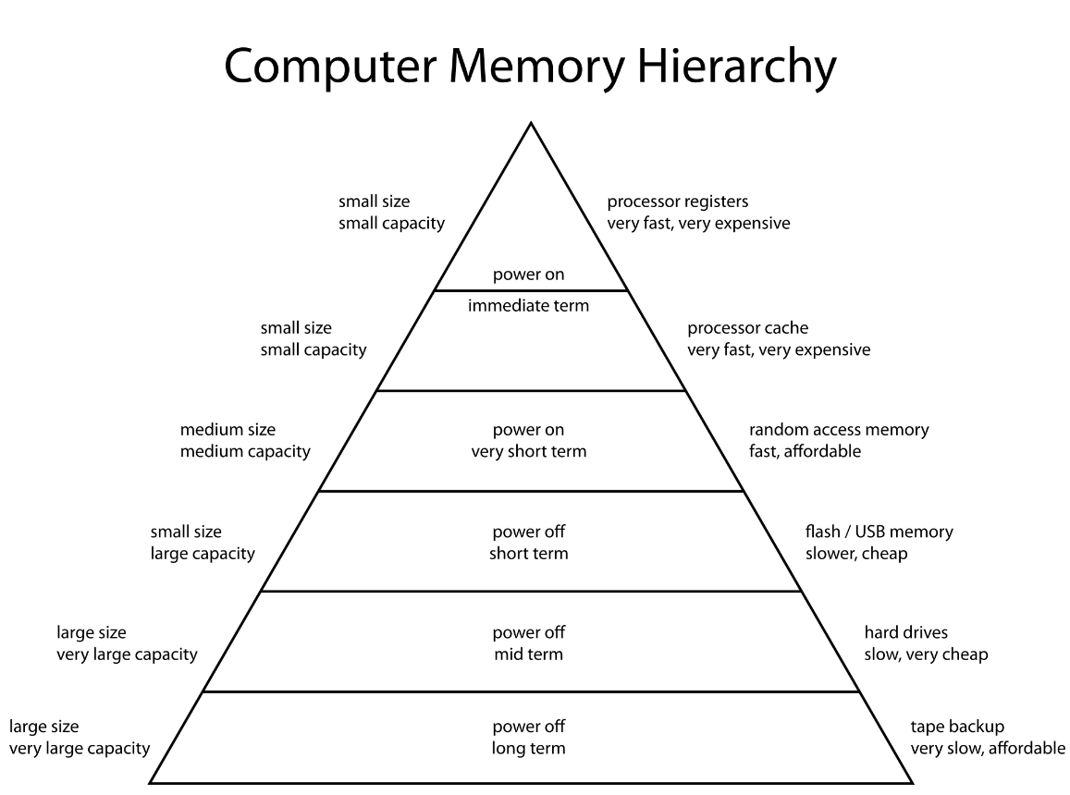
Memory heirarchy
Basic idea: look for data in small fast memory first
On a miss, look in slower bigger memory
Write is similar to read

Slide 29
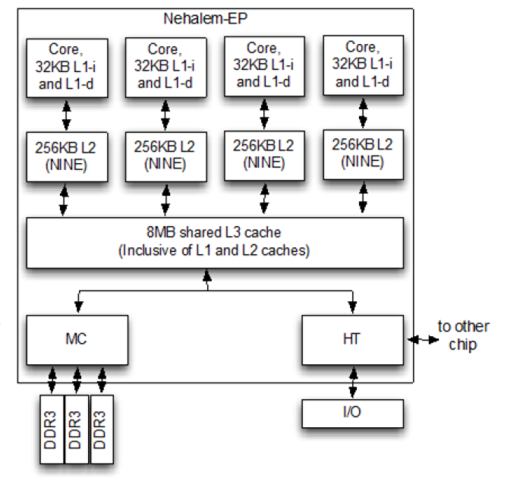
Real example: Intel Nehalem
Example timings (not real):
main memory = 50 ns, L1 = 1 ns (10% miss rate), L2 = 5 ns (1% miss rate), L3 = 10 ns (0.2% miss rate) [Wikipedia]

Slide 30
Practical consequences
Data structures and algorithms that are smart about memory access can be WAY faster than ones that are dumb
Key idea: exploit locality in space and time
Consequence of cache layout, and refill strategy
Classical example: array access
Row major or column major order?
Prim versus Kruskal?
Cache management is quite complex on modern hardware

